Slide 1

Telephone Directory
Given By
Dillip Rout

Slide 2

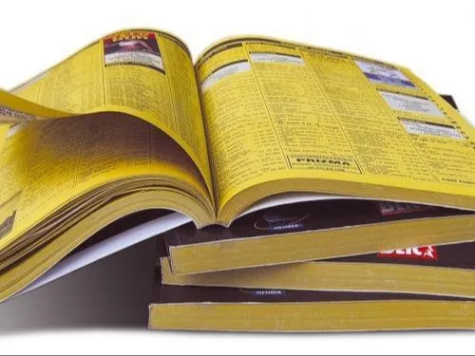
Team Members
PRIYANSHU KUMARI 2201020106
SARANG KUMAR SINGH 2201020123
SOFIA AKHTAR 2201020130
SOURAV RAUT 2201020133
SUDEEP SWARANKAR 2201020138
SUGAM SHAW 2201020139

Slide 3

Contacts are the threads that weave the fabric of our connections. Let's make them easy to find and a joy to manage.

Slide 4

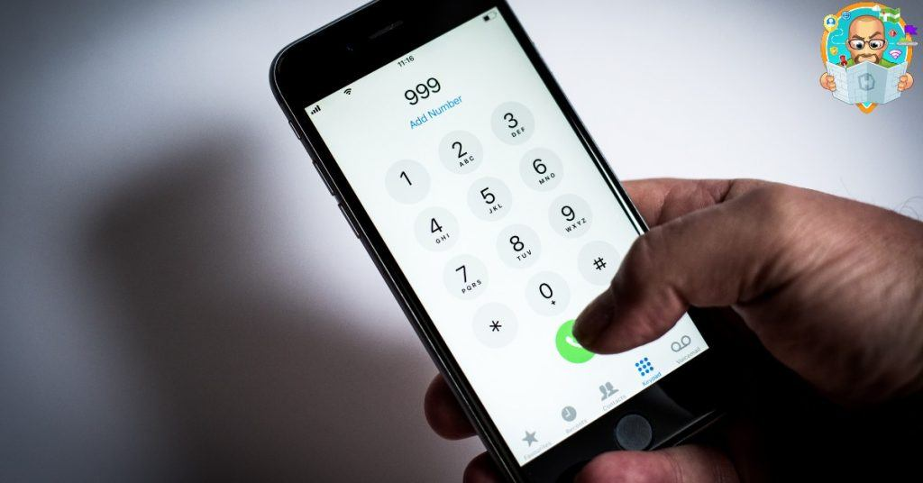
Problem Statement
Design an efficient data structure for a contact book application that supports operations such as insertion, searching, sorting by name, categorizing, scanning, and deletion. The application should also provide real-time suggestions to the user as they enter characters for searching, making use of data structures that enable quick and dynamic prefix-based queries.

Slide 5

Solution
The provided C program offers a comprehensive solution for a phone directory application. It includes features for account management, such as creating new accounts, logging in, deleting accounts, and resetting passwords. User account data is stored in a CSV file, and these accounts are managed using a linked list data structure.
Additionally, the program allows users to manage their contacts, enabling the creation, deletion, editing, and searching of contacts. Contact data is also stored in CSV files, one for each user, and loaded into linked lists for efficient management.
Overall, this program provides users with a user-friendly interface for managing their phone contacts and accounts, making it a practical solution for organizing personal contact information.

Slide 6
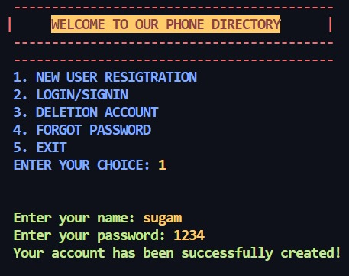
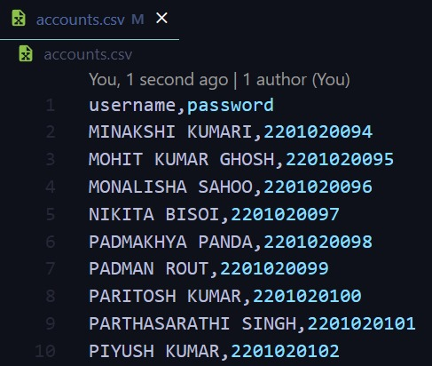
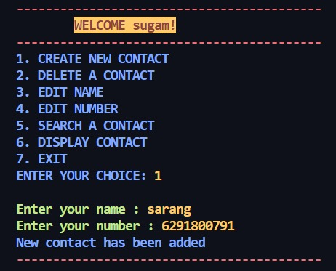
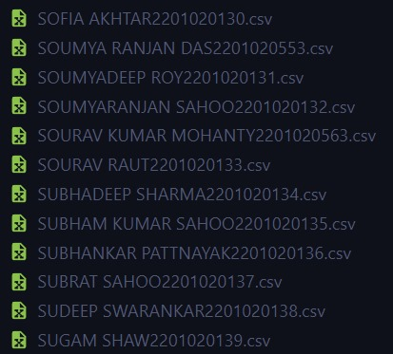
Features
Basic contact management (add, search, sort, categorize, delete).
Real-time search suggestions for improved user experience.
Automatic duplicate contact detection and cleanup.
Contact editing for data accuracy and organization.

Slide 7
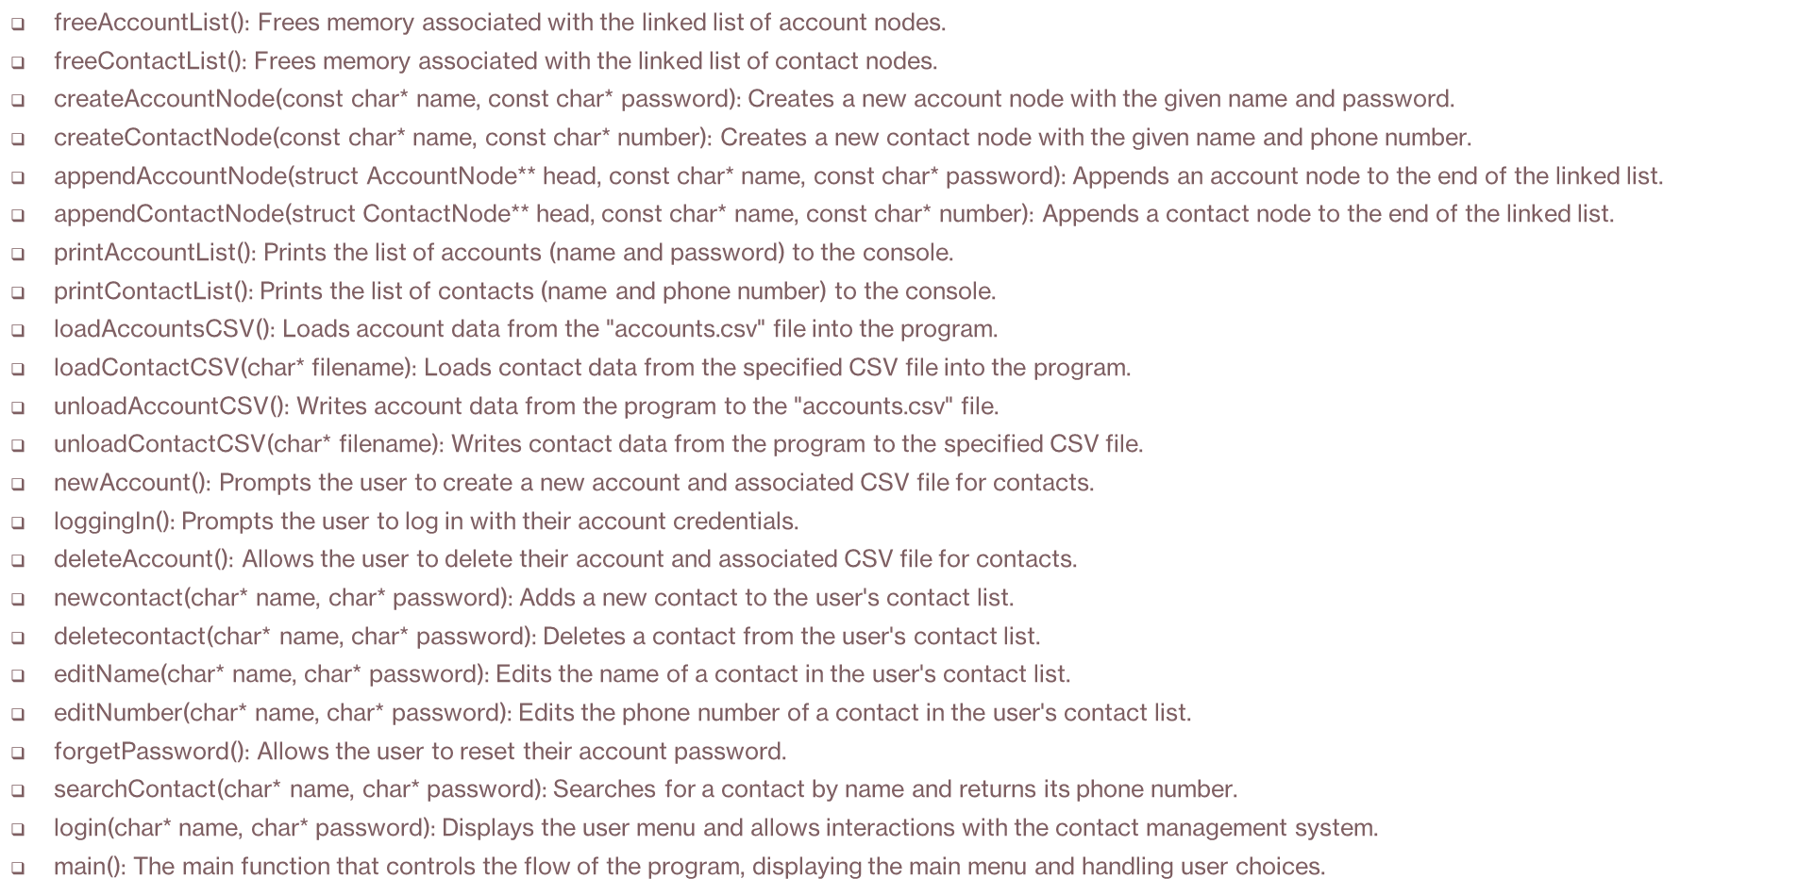
Funtions

Slide 8
Research Papers
Report On Telephone Directory System
https://vdocuments.net/project-report-on-telephone-directory-system.html?page=1
chrome-extension://efaidnbmnnnibpcajpcglclefindmkaj/https://www.ijstr.org/final-print/mar2020/Phone-Directory-Using-Mobile-Application.pdf
Development of a Mobile Based Directory
https://www.academia.edu/38433396/DEVELOPMENT_OF_A_MOBILE_BASED_DIRECTORY_FOR_BUSINESS_IDENTIFICATION_AND_LOCATION
Mobile Device Security
https://basis.ucdavis.edu/publication/paper-telephone-directories-mobile-phone-networks
Telephone Directories for Mobile Phone Networks
https://r.search.yahoo.com/_ylt=Awr1Tm9g8g5lPCAs1cq7HAx.;_ylu=Y29sbwNzZzMEcG9zAzUEdnRpZAMEc2VjA3Ny/RV=2/RE=1695507169/RO=10/RU=http%3a%2f%2fwww.aasmr.org%2fjsms%2fVol12%2fJSMS%2520April%25202022%2fVol.12No.02.04.pdf/RK=2/RS=tYH7OVUAMq5UkjNDIXu685eEppk-
Development Of A Mobile Based Directory

Slide 9
Future Aspects
Modification of the existing data structure to support multiple phone numbers for a single contact.
Efforts to ensure that operations involving multiple phone numbers for a contact have efficient time complexities, ideally O(1) or O(n).
Efficient management of space usage, considering the number of contacts and the maximum number of phone numbers per contact.

Slide 10

In conclusion, these future enhancements represent our commitment to providing a robust and user-centric contact management system. We look forward to implementing these improvements to make managing multiple phone numbers effortless and efficient.

